Slide 1
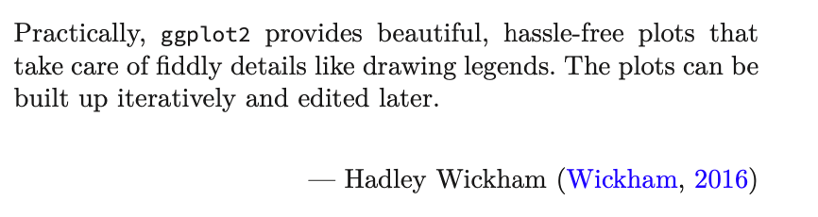
Exploring Operations Research with R: A Workshop
05 – Operations Research Examples
https://github.com/JimDuggan/Exploring-OR-with-R-Workshop

Slide 2
Topics Overview
Topic | Description | ~Timing
1 | Introduction to R and Posit Cloud | 10 mins
2 | Storing data using data frames / tibbles | 10 mins
3 | Visualisation with ggplot2 | 20 mins
4 | Data transformation with dplyr | 20 mins
5 | Using R with OR – Four Examples | 30 mins
Example | Description
1 | Exploratory Data Analysis
2 | Linear Programming
3 | Agent Based Simulation
4 | Data transformation with dplyr

Slide 3
(1) Exploratory Data Analysis
“Exploratory analysis is what you do to understand the data and figure out what might be noteworthy or interesting to highlight to others. When we do exploratory analysis, it’s like hunting for pearls in oysters.”
Cole Nussbaumer Knaflic (Knaflic, 2015)

Slide 4
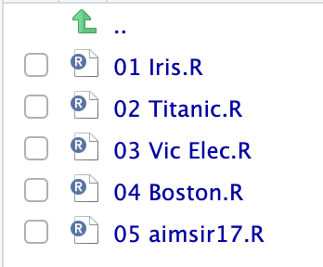
EDA Code Examples
Iris Flowers
Titanic
Victoria Electricity
Boston Housing
Irish Weather

Slide 5
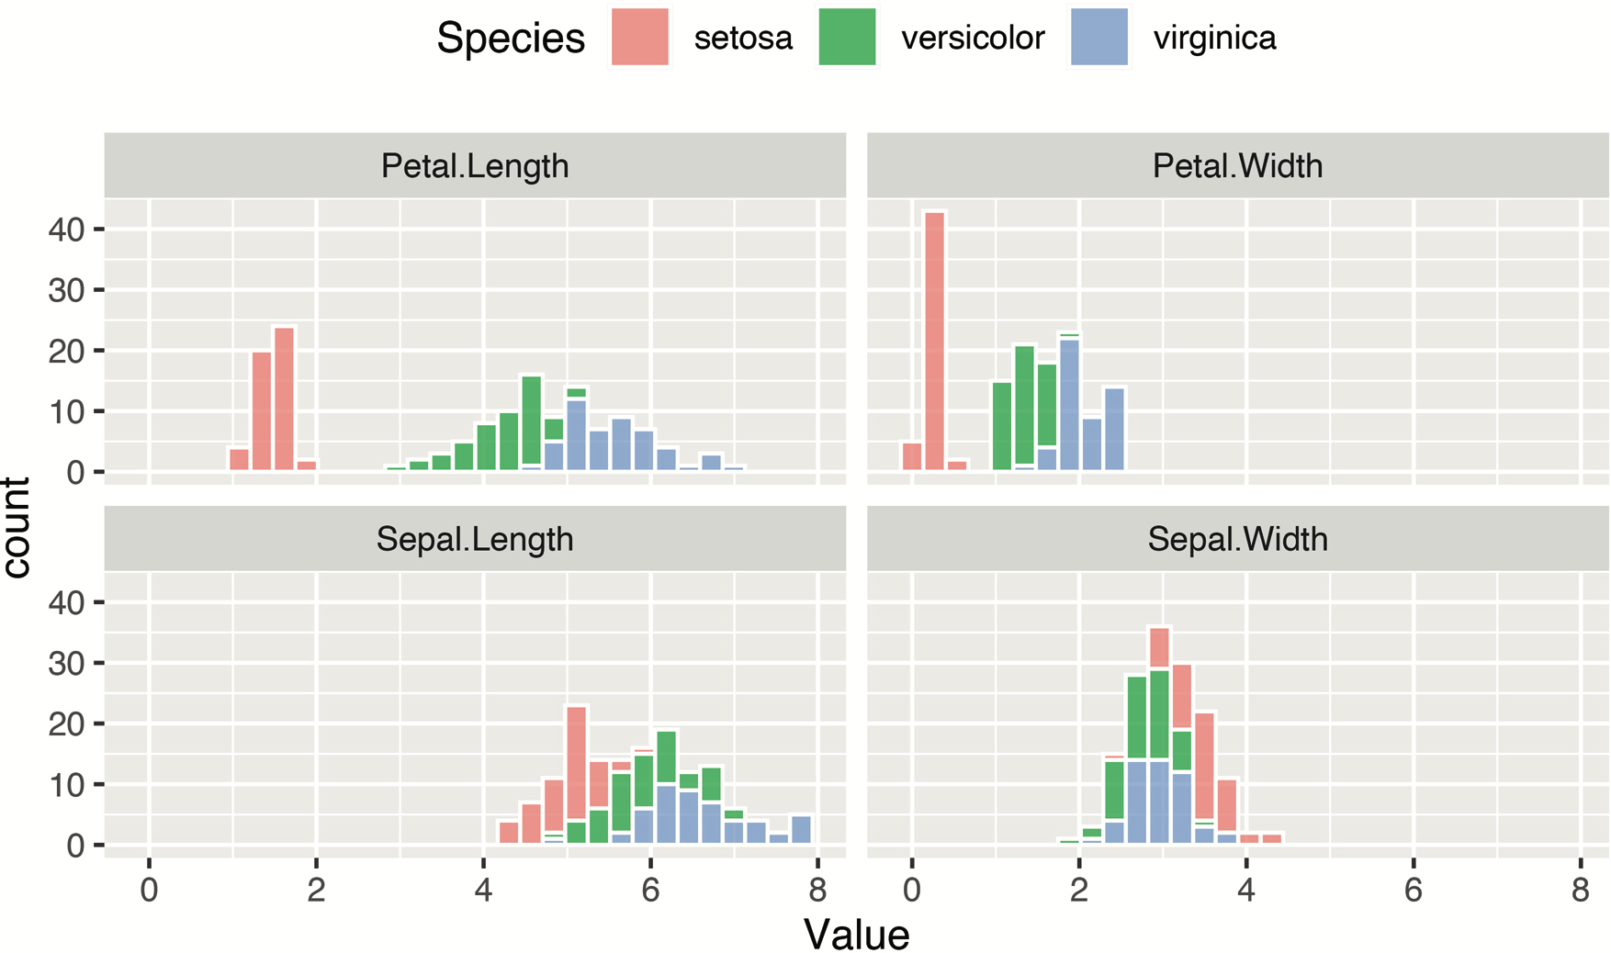
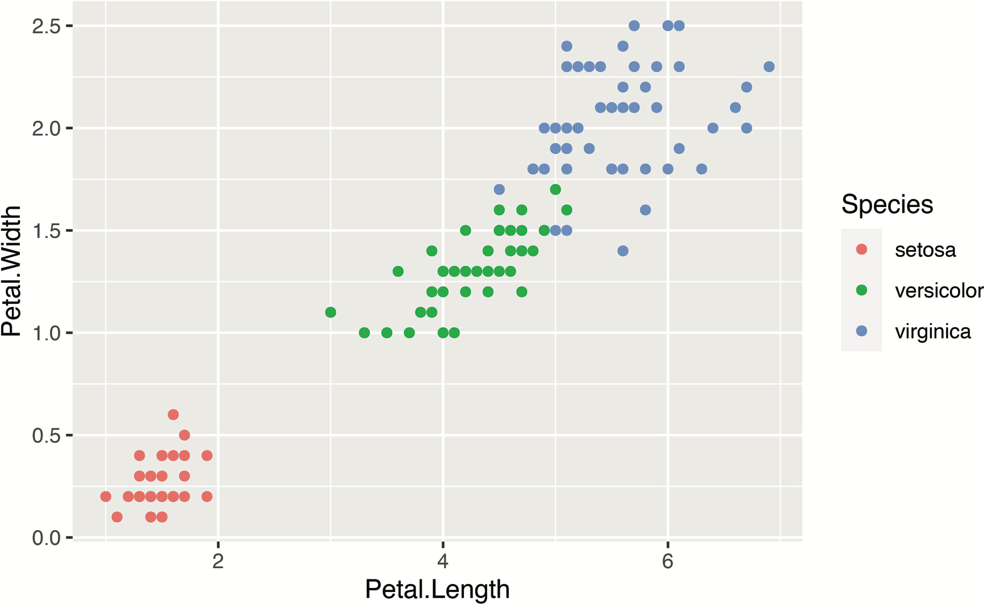
(1) Iris Data Set

Slide 6
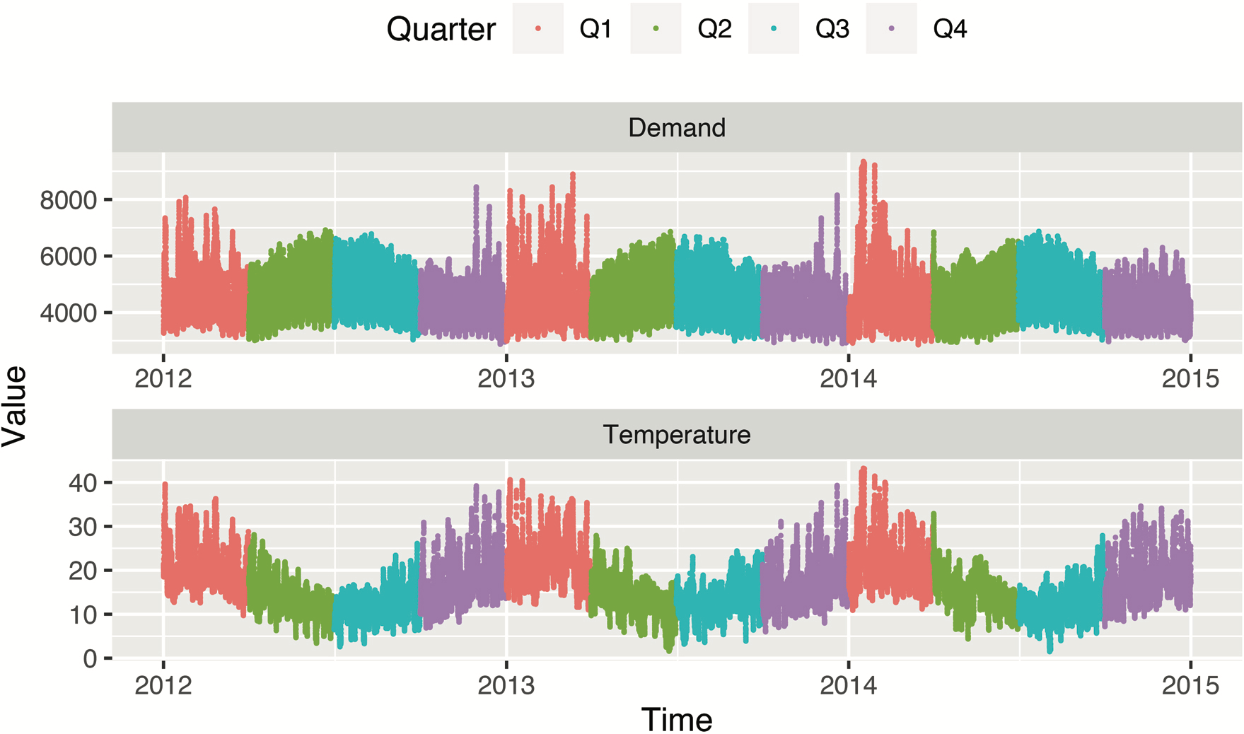
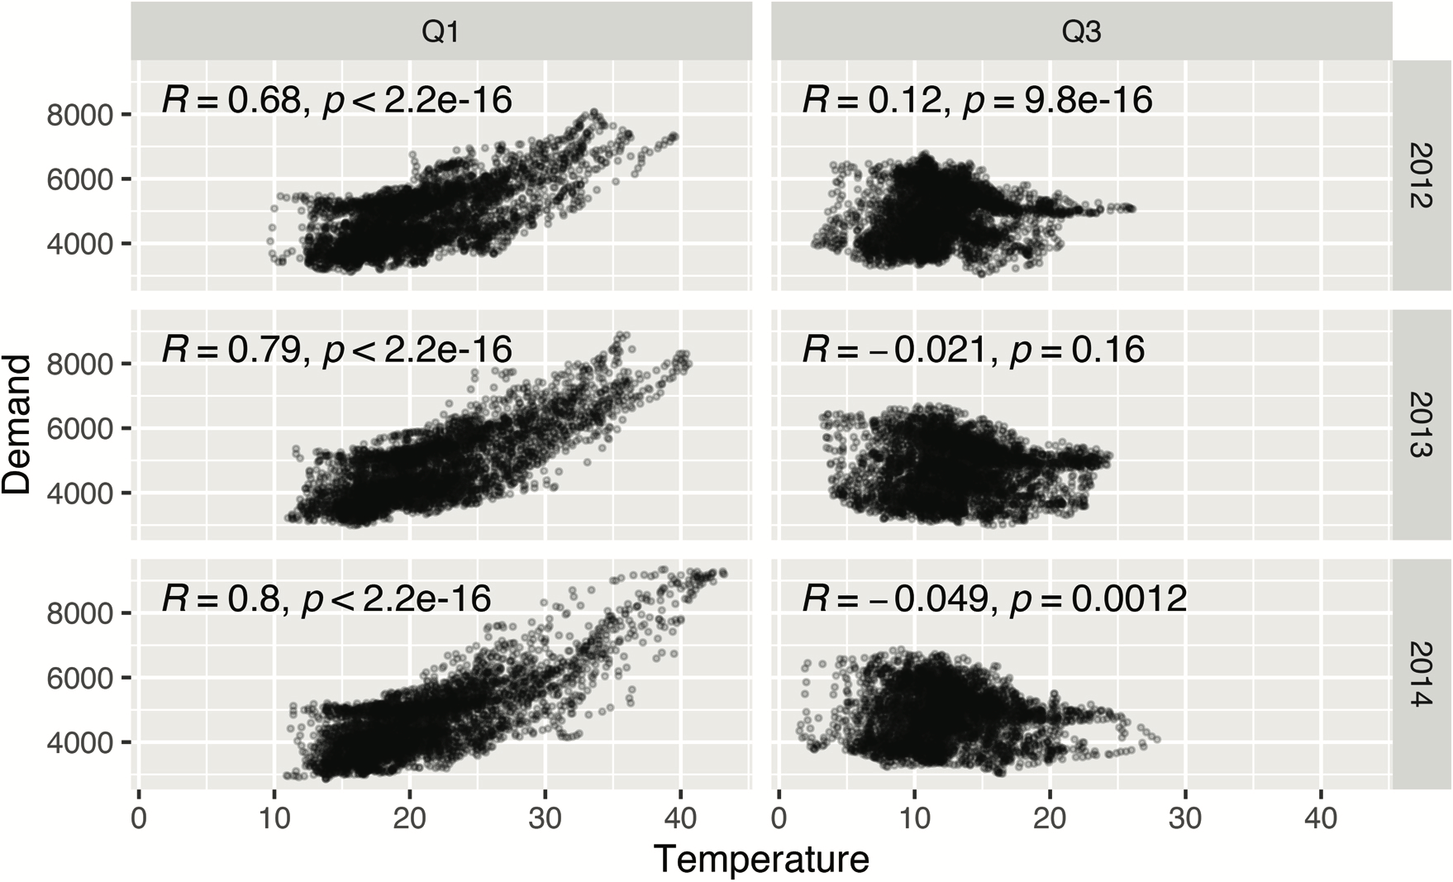
(2) Electricity Demand (Victoria)

Slide 7
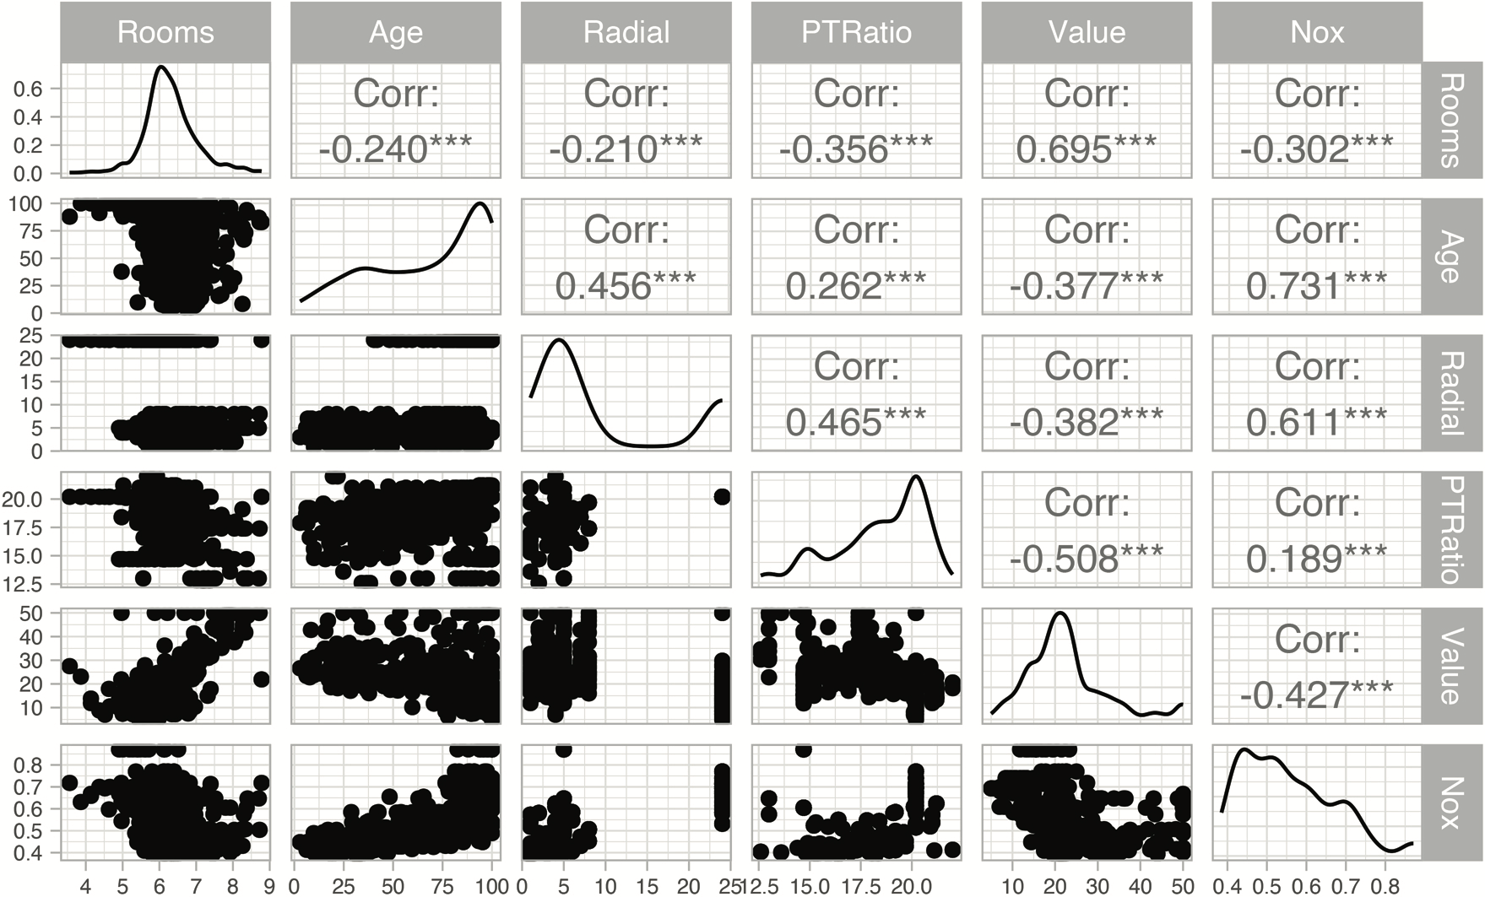
(3) Boston Data

Slide 8
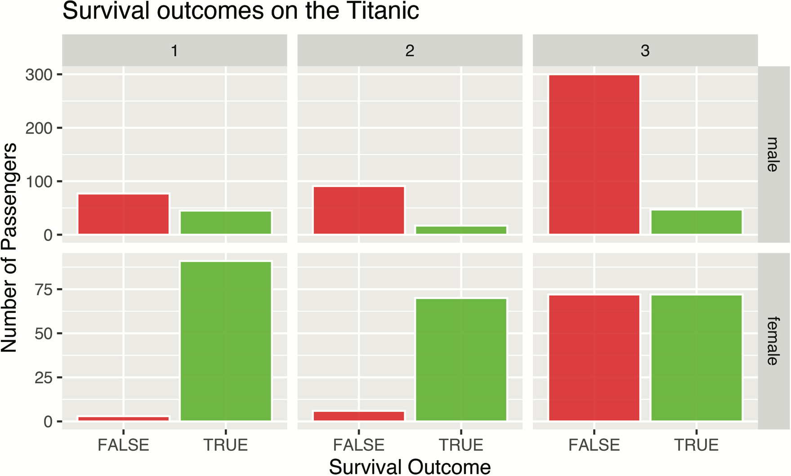
(4) Titanic Survival Data

Slide 9
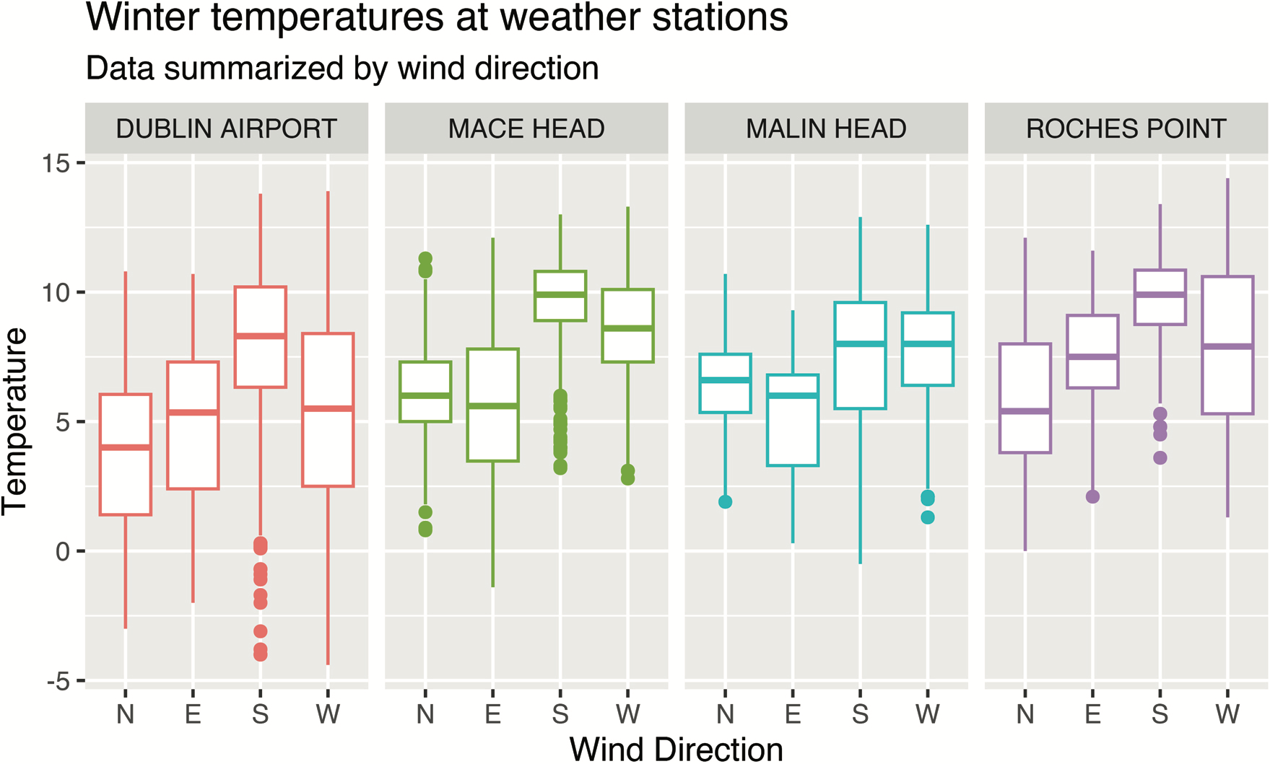
(5) Irish Weather Analysis (Winter)

Slide 10
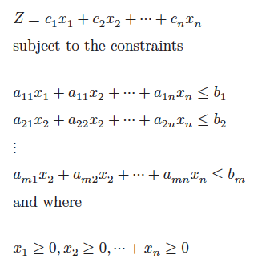
(2) Linear Programming
“The success of an OR technique is ultimately measured by the spread of its use as a decision making tool. Ever since in introduction in the late 1940s, linear programming (LP) has proven to be one of the most effective operations research tools.”
Hamdy A. Taha (Taha, 1992)

Slide 11
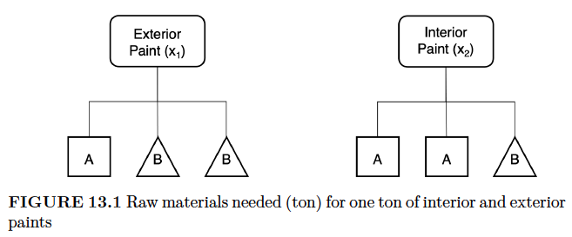
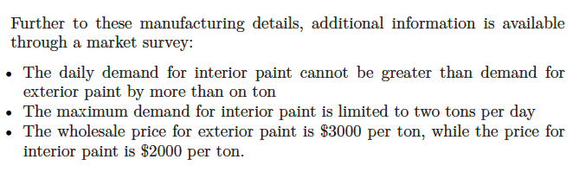
The Reddy Mikks example (Taha 1995)

Slide 12
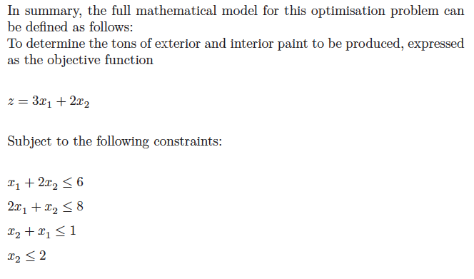
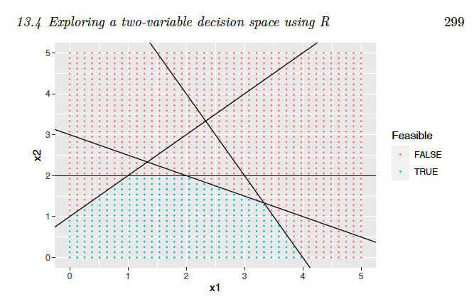
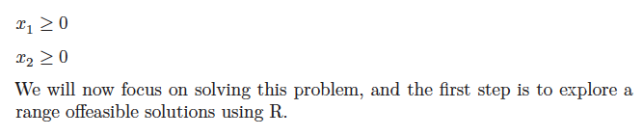

Slide 13
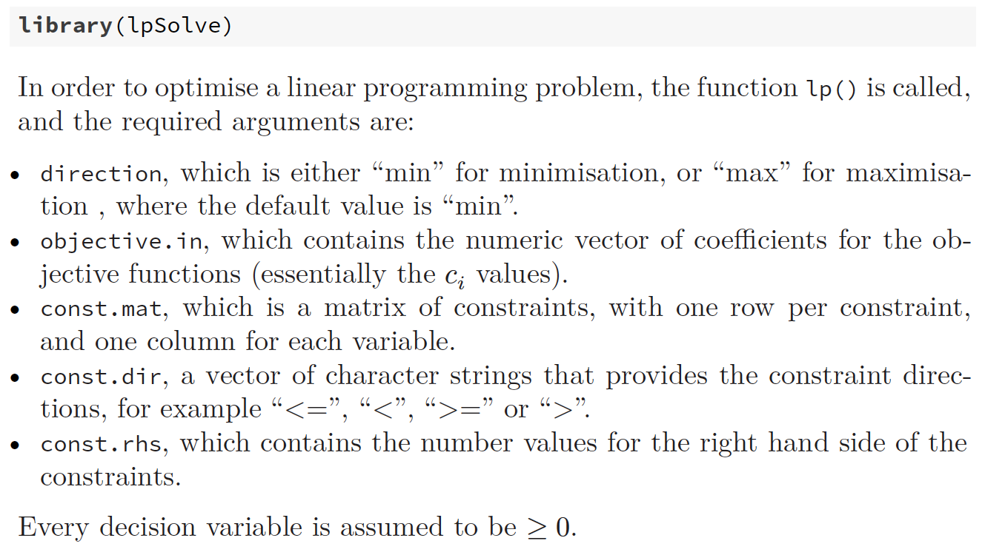

Slide 14
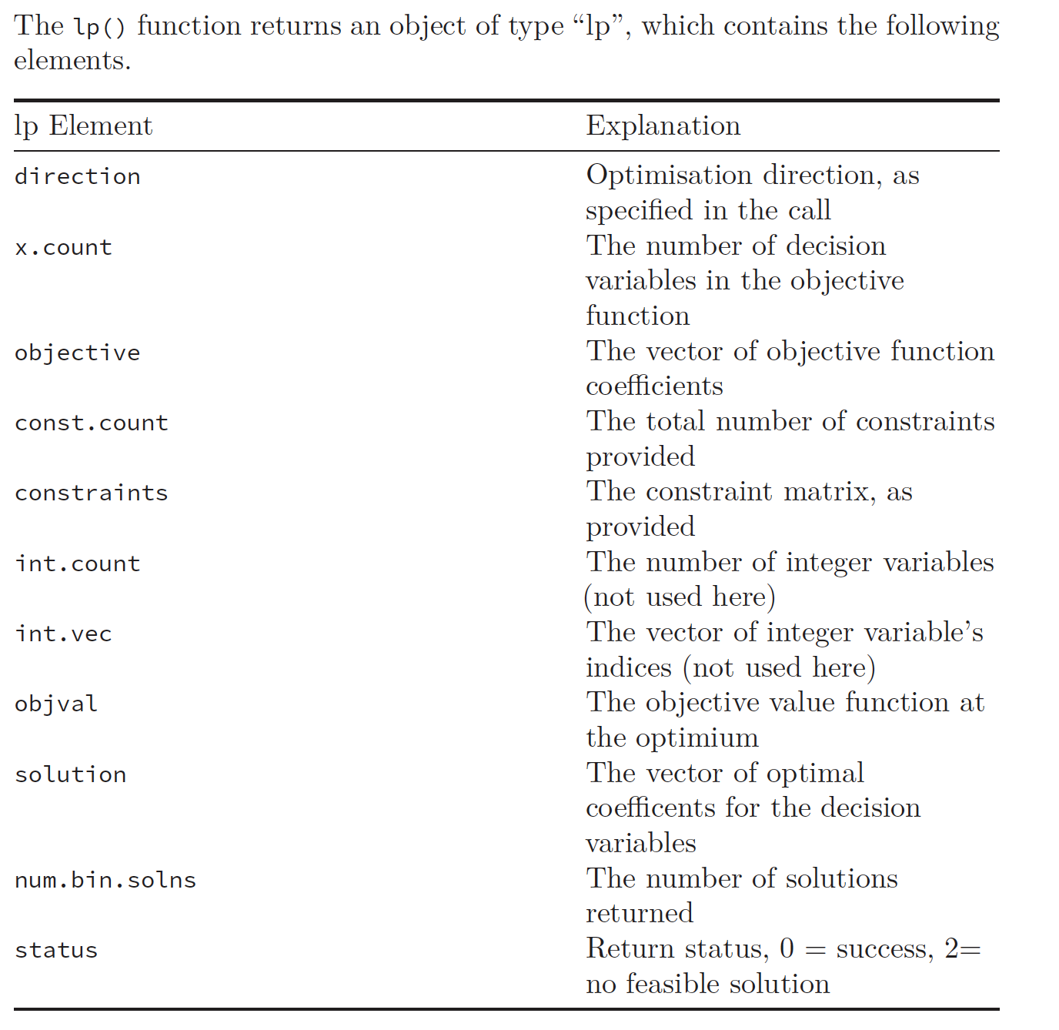

Slide 15
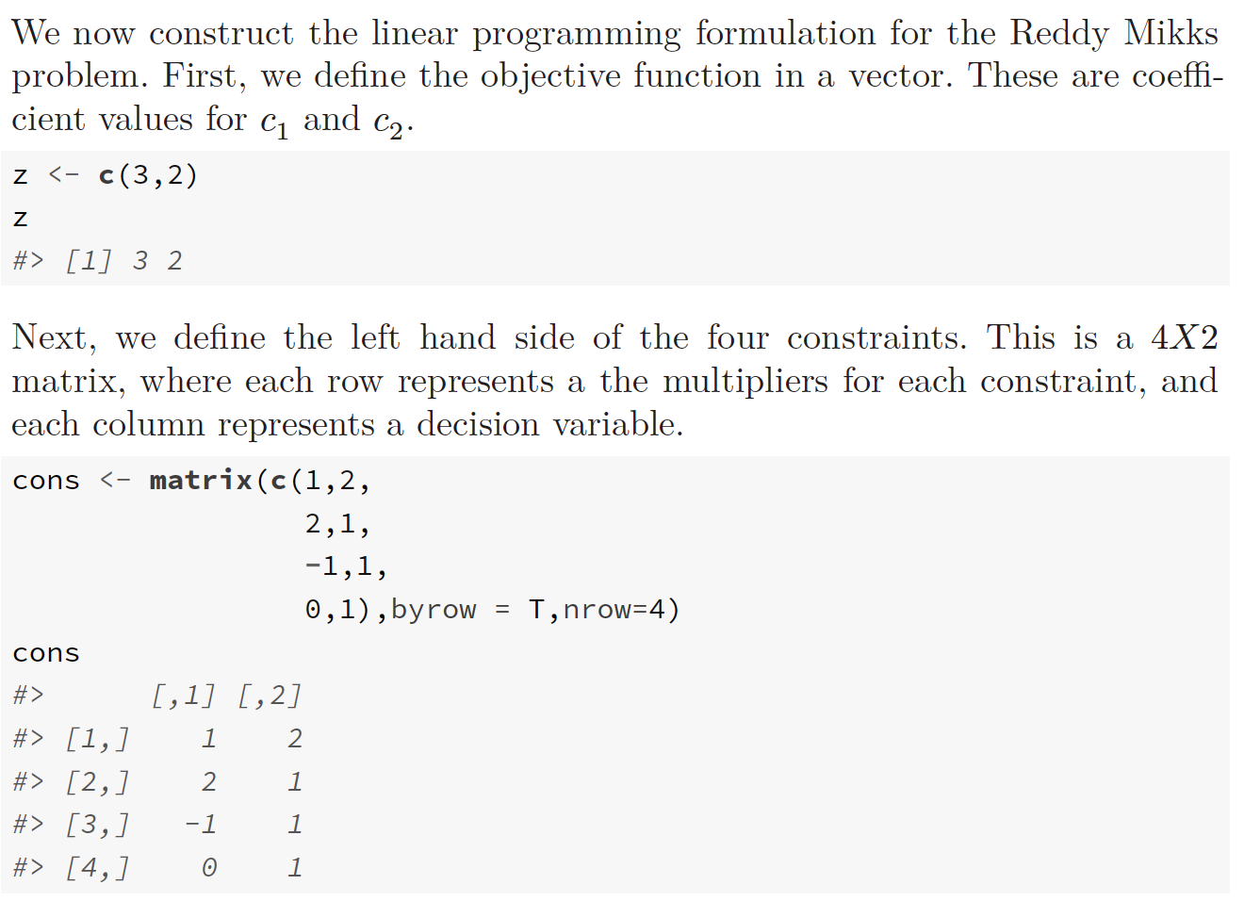

Slide 16
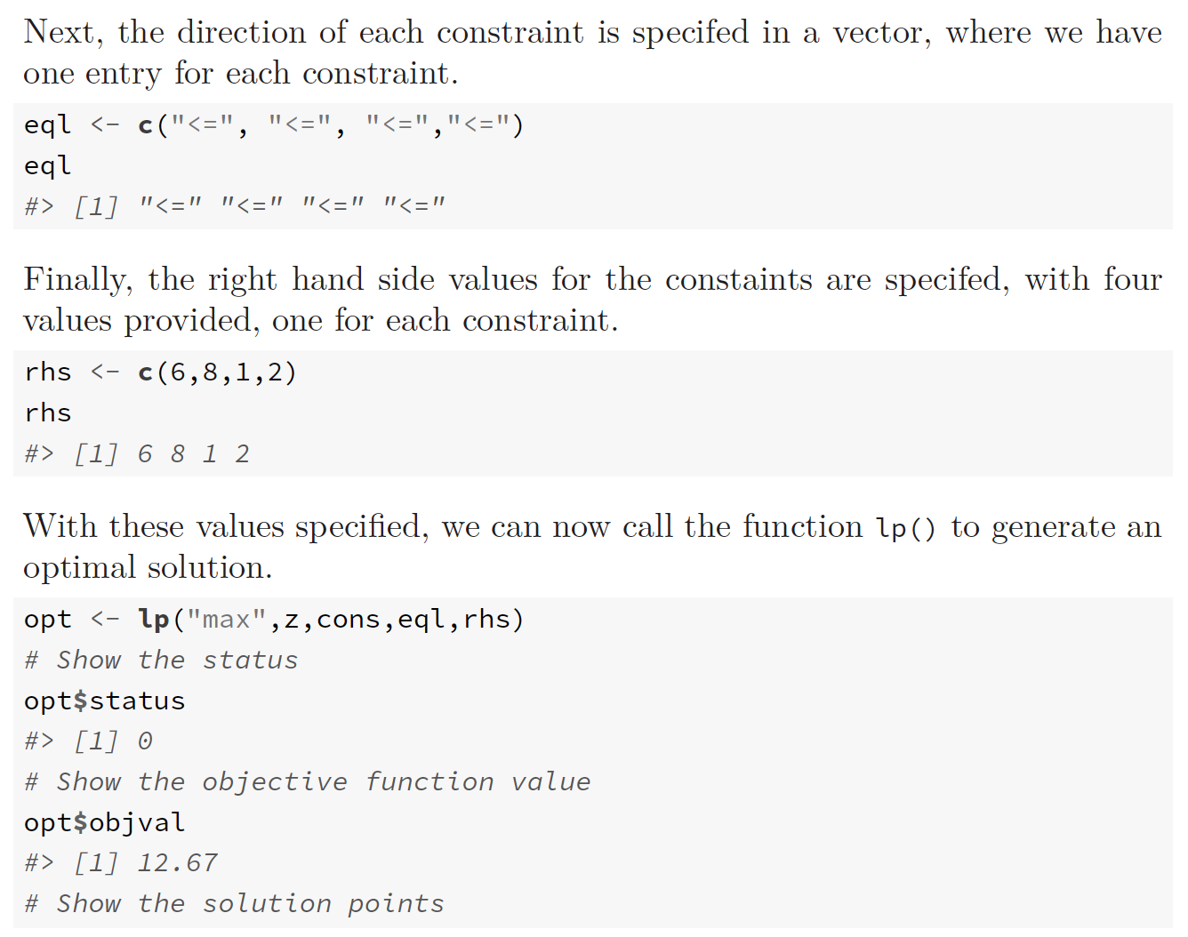

Slide 17
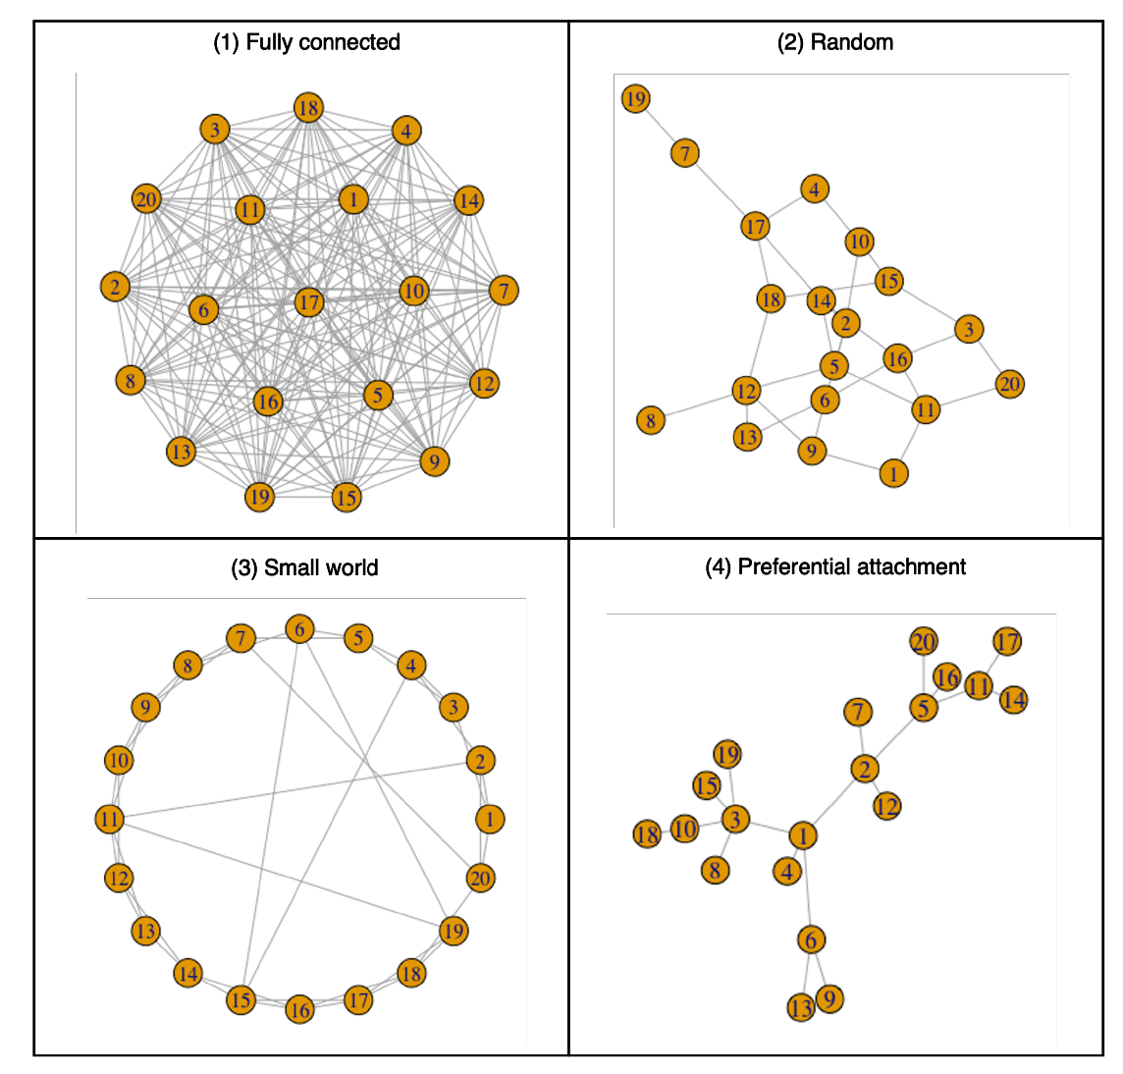
(3) Agent Based Simulation
Situate an initial population of autonomous heterogeneous agents in a relevant spatial environment; allow them to interact according to simple local rules, and thereby generate – or “grow” - the macroscopic regularity from the bottom up.
Joshua M. Epstein (Epstein, 2012)

Slide 18
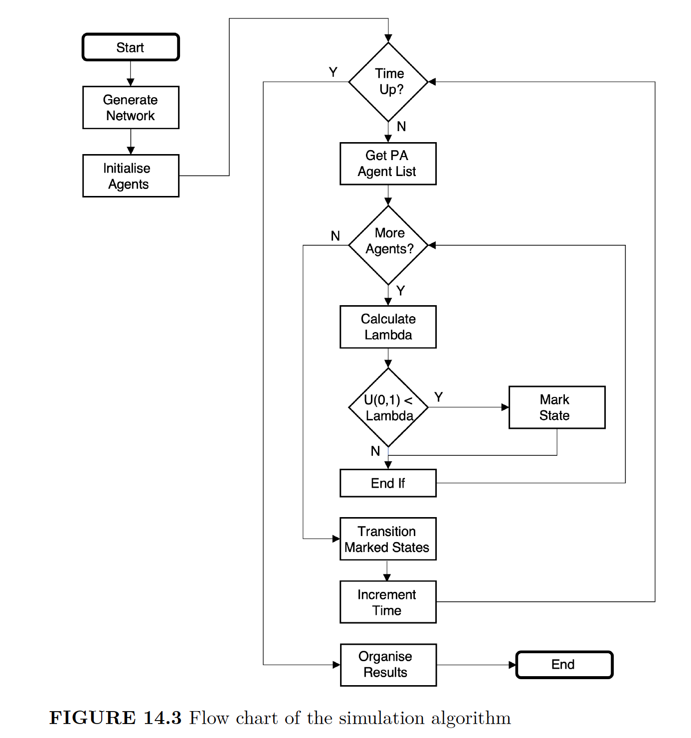
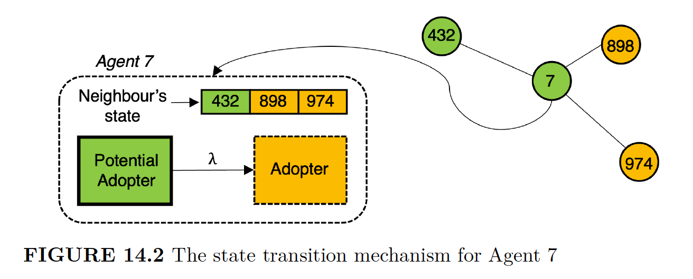

Slide 19
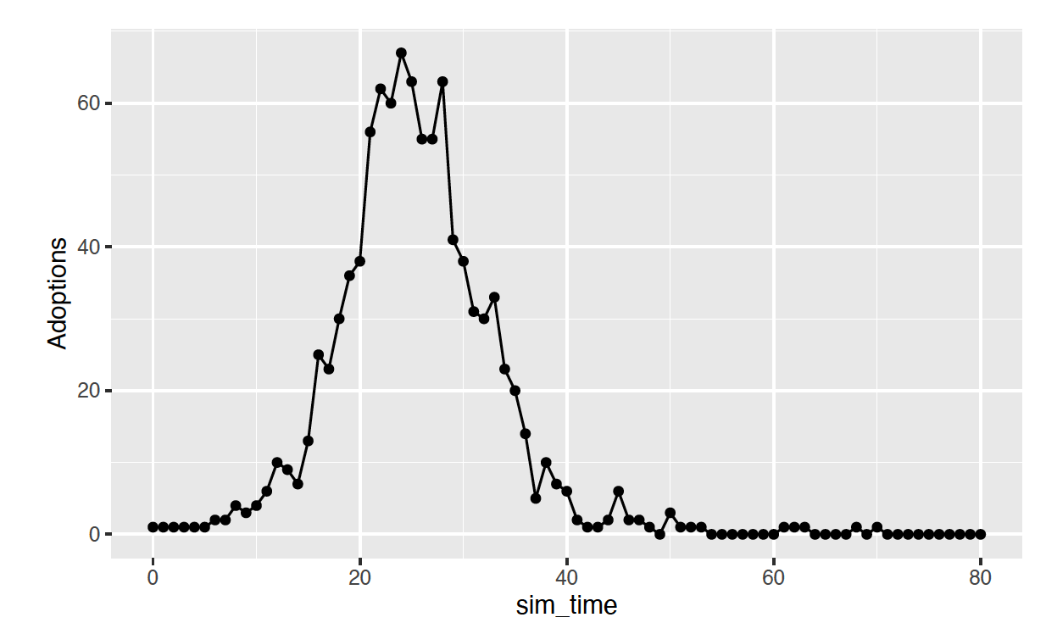
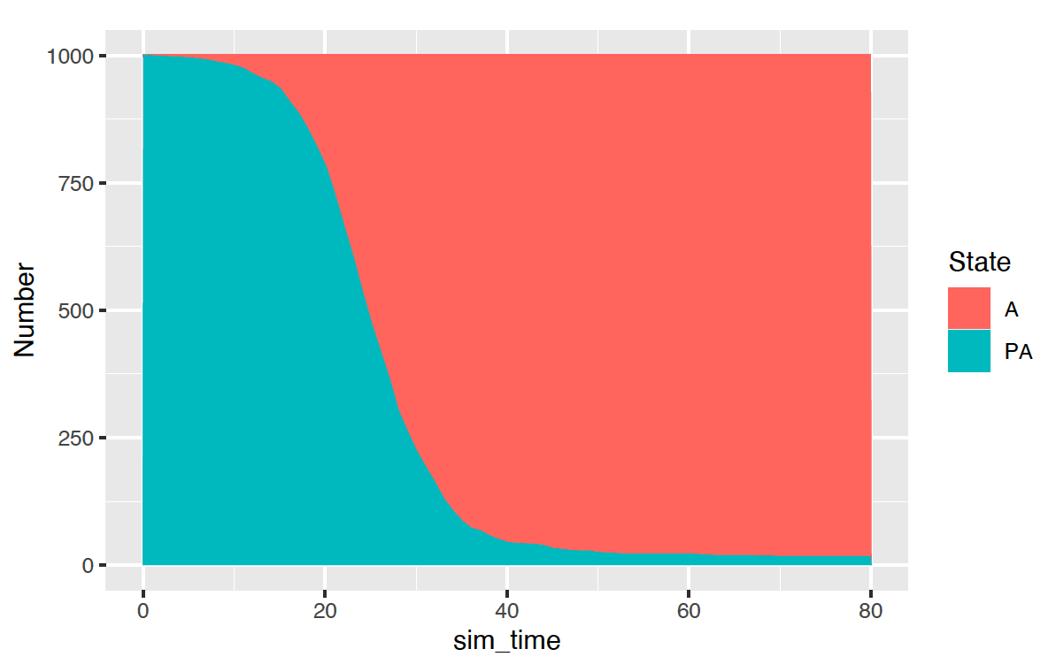
A single run…

Slide 20
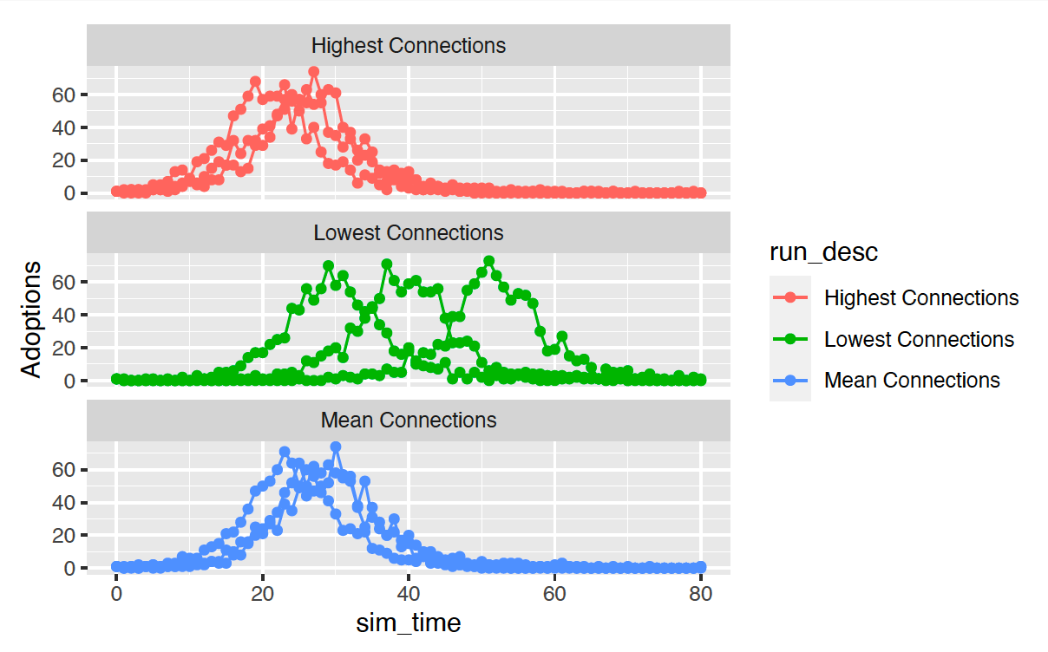
Three Scenarios (Different seeded individual)

Slide 21
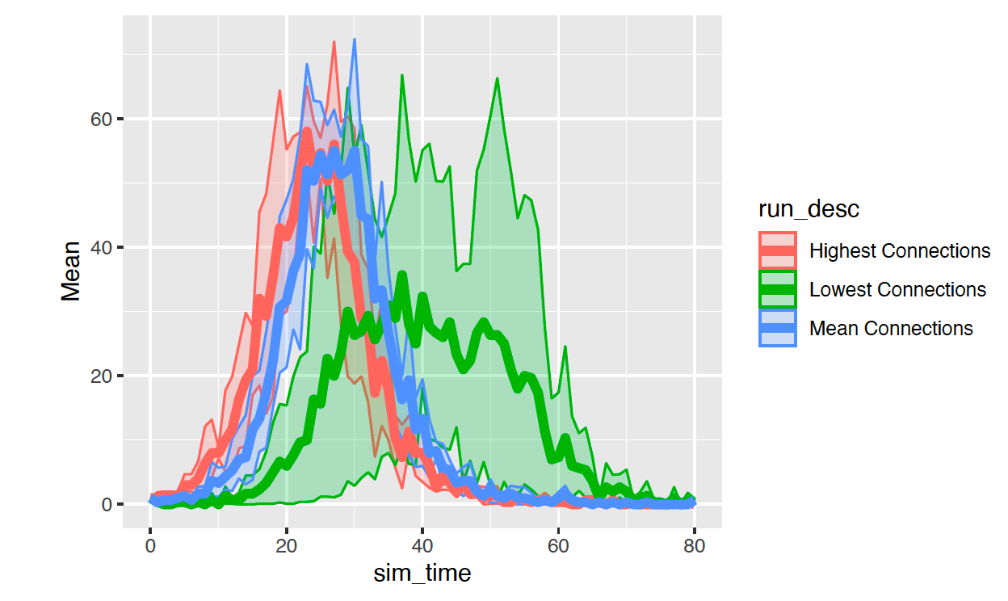
Quantile analysis

Slide 22
(4) System Dynamics
“Everything we do as individuals, as an industry, or as a society is done in the context of an information-feedback system.”
Jay W. Forrester (Forrester, 1961)

Slide 23
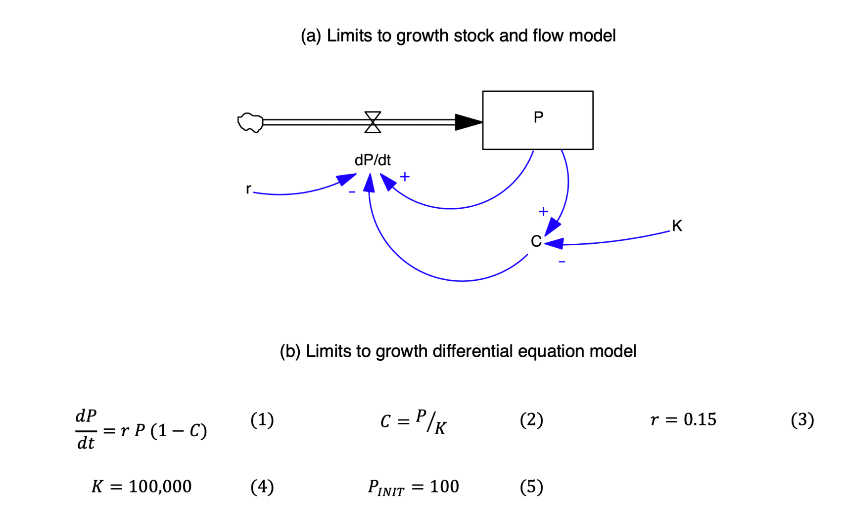
Limits to Growth Model

Slide 24
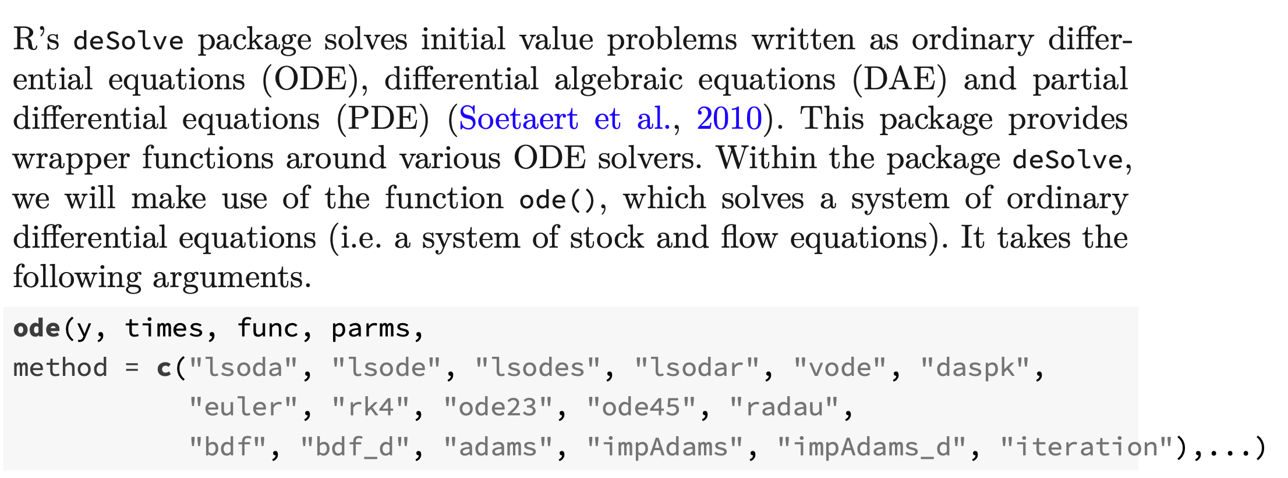
deSolve

Slide 25
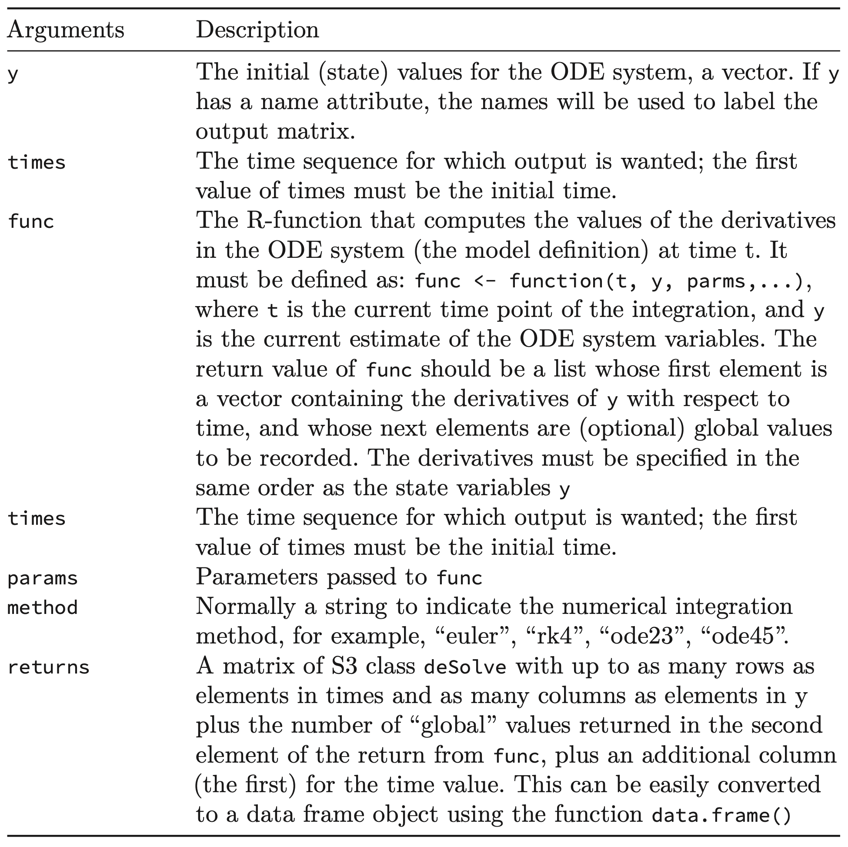

Slide 26
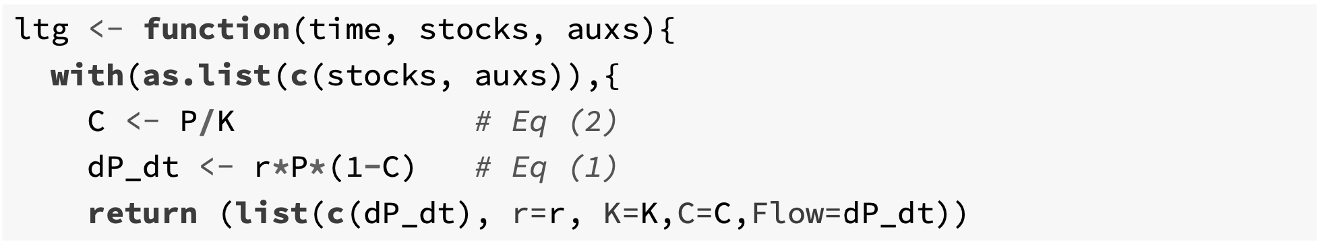
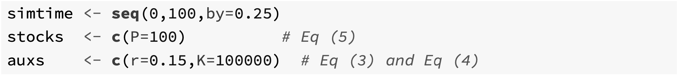
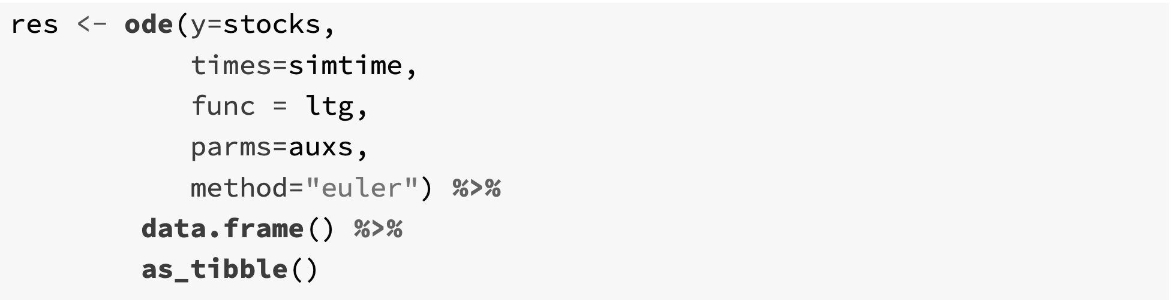

Slide 27
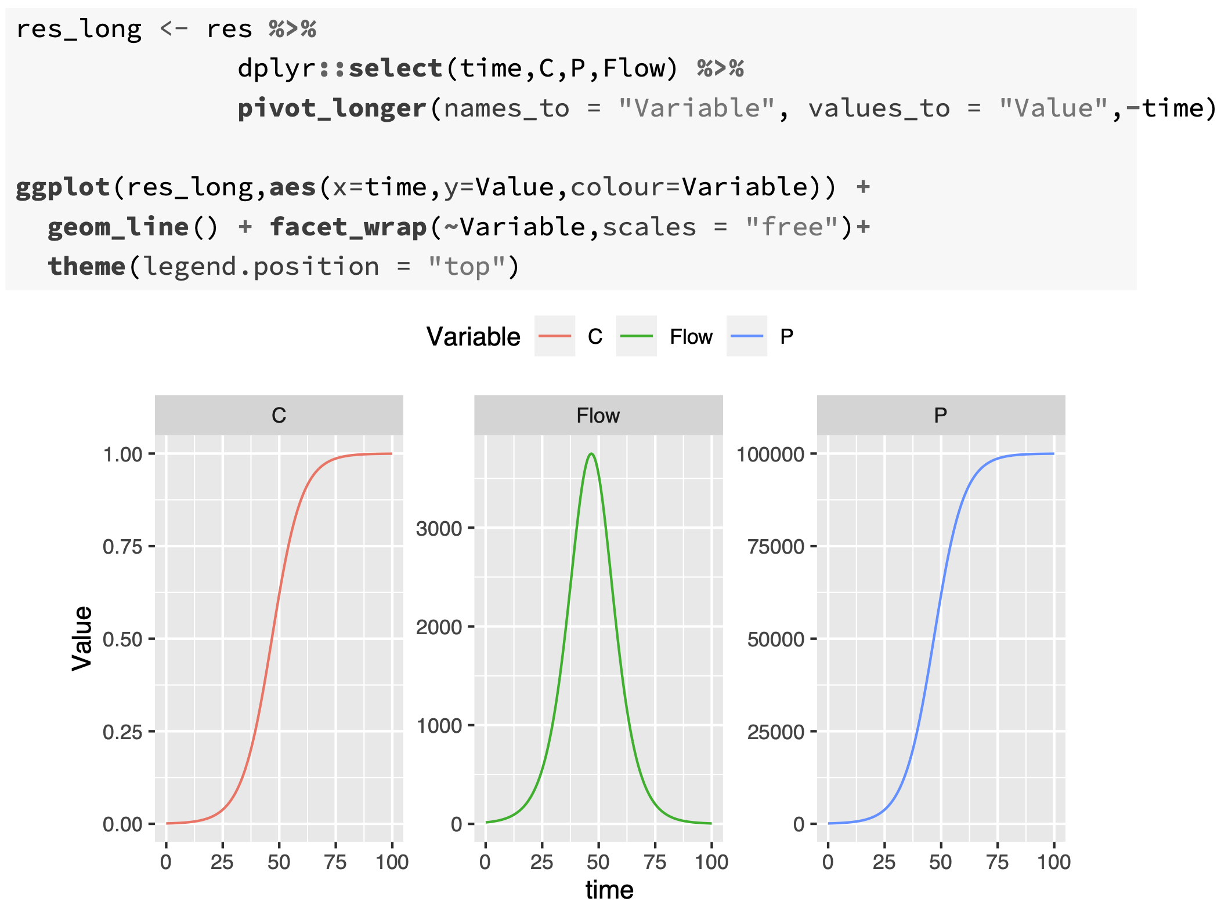
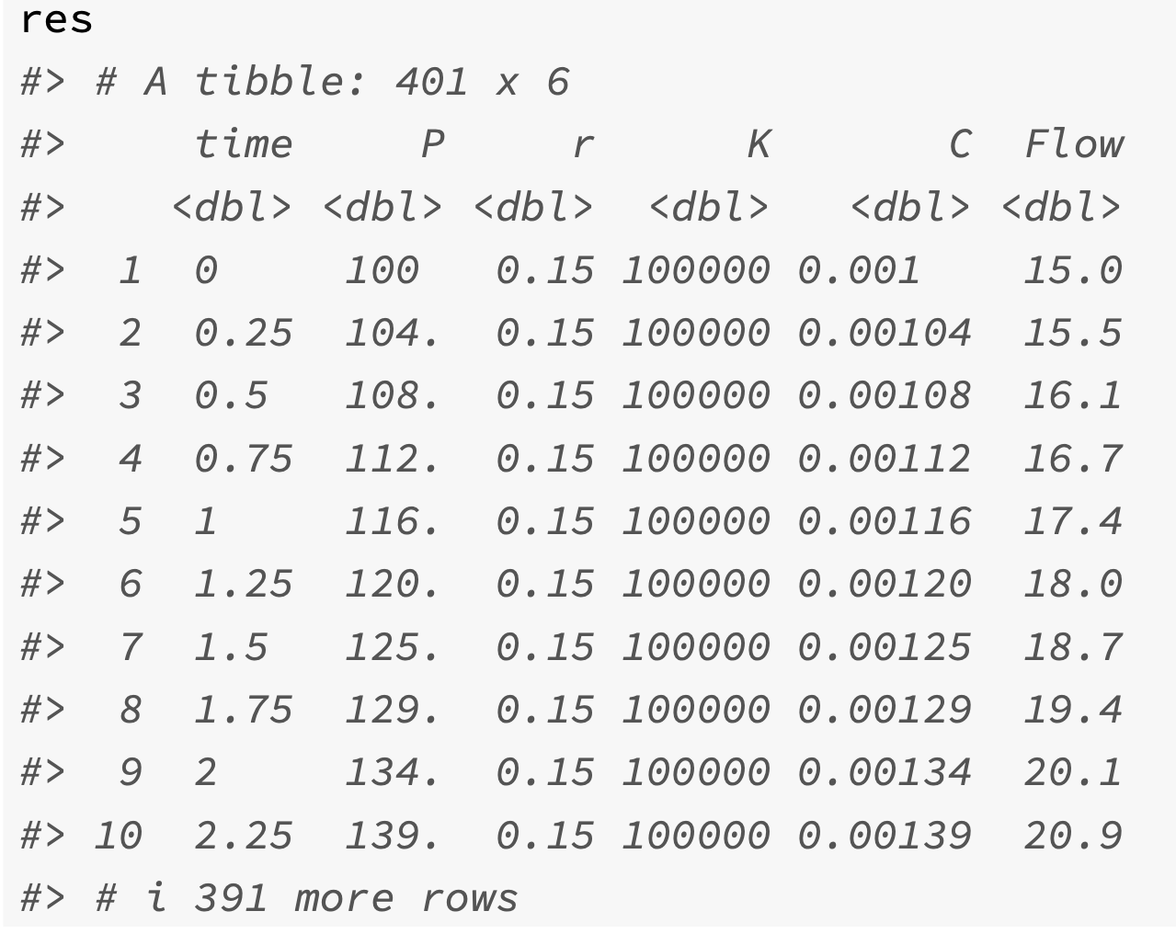

Slide 28
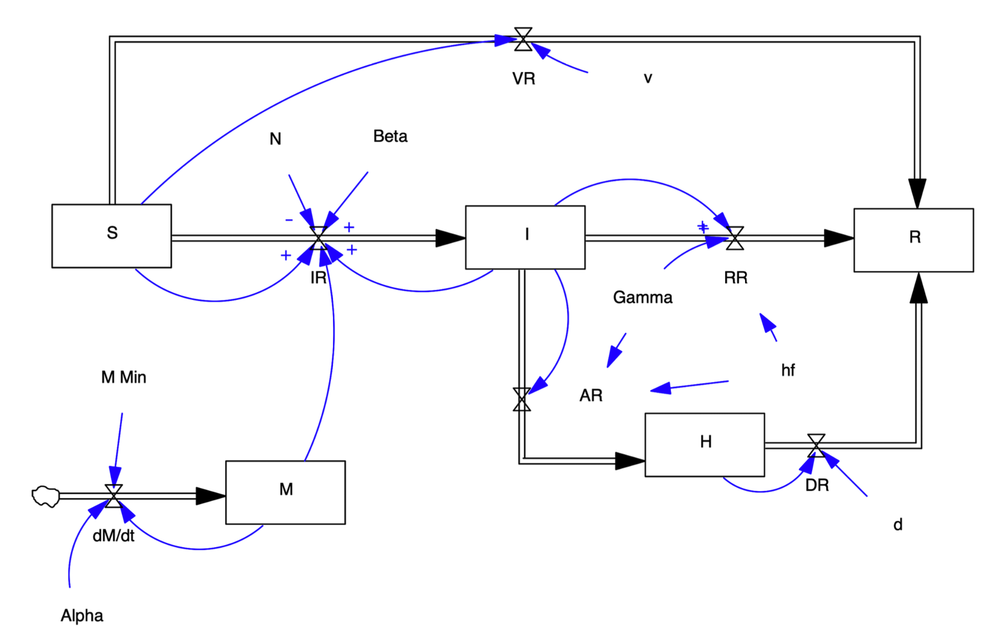
SIRH Model

Slide 29
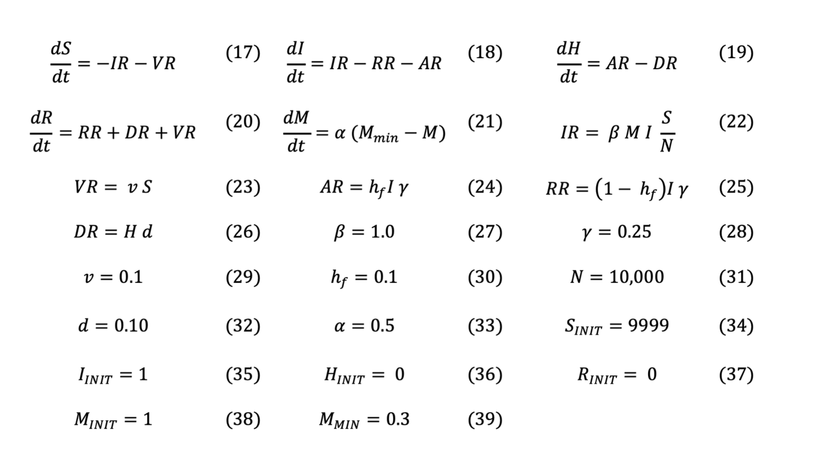

Slide 30
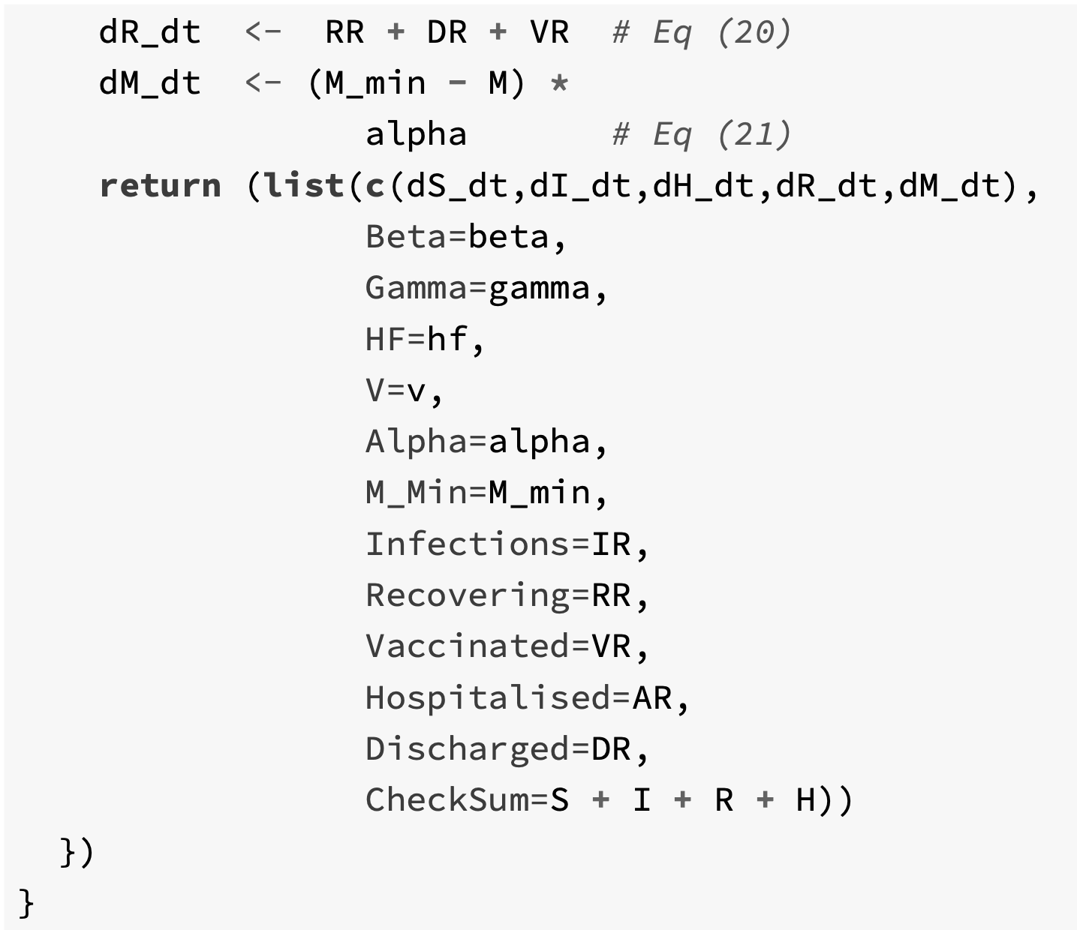
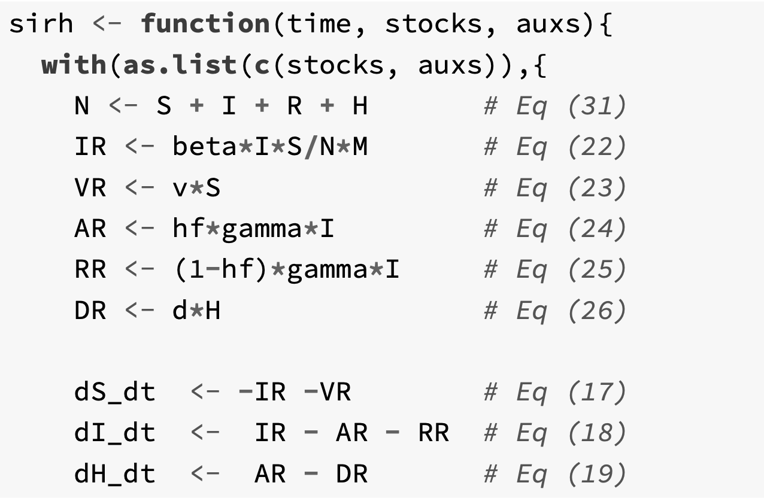

Slide 31
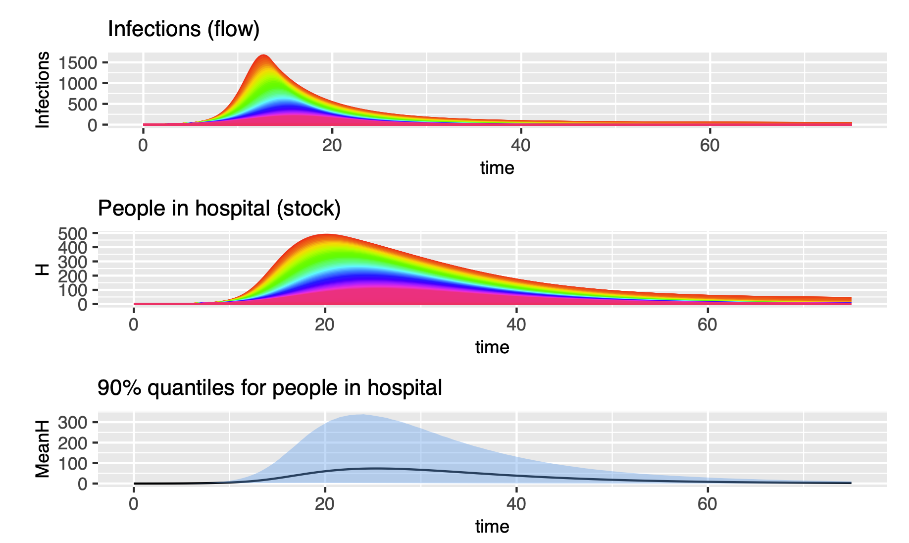

Slide 32
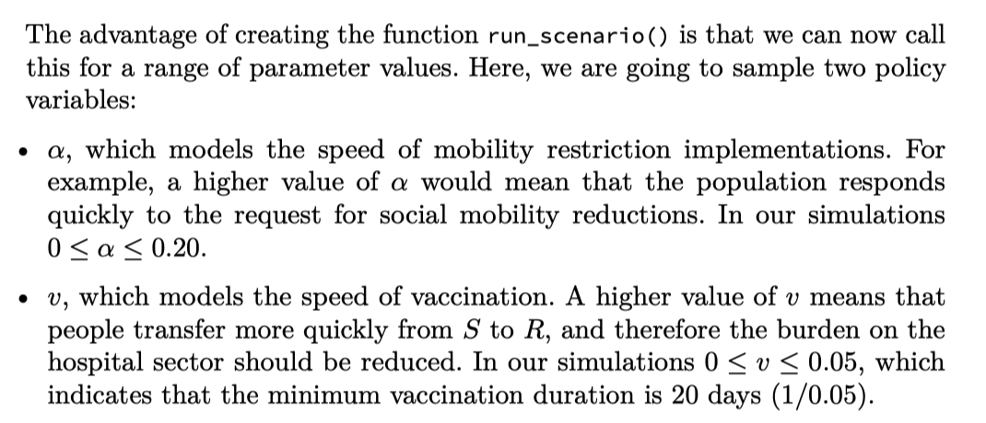
Exploring scenarios: 2 policy levers

Slide 33
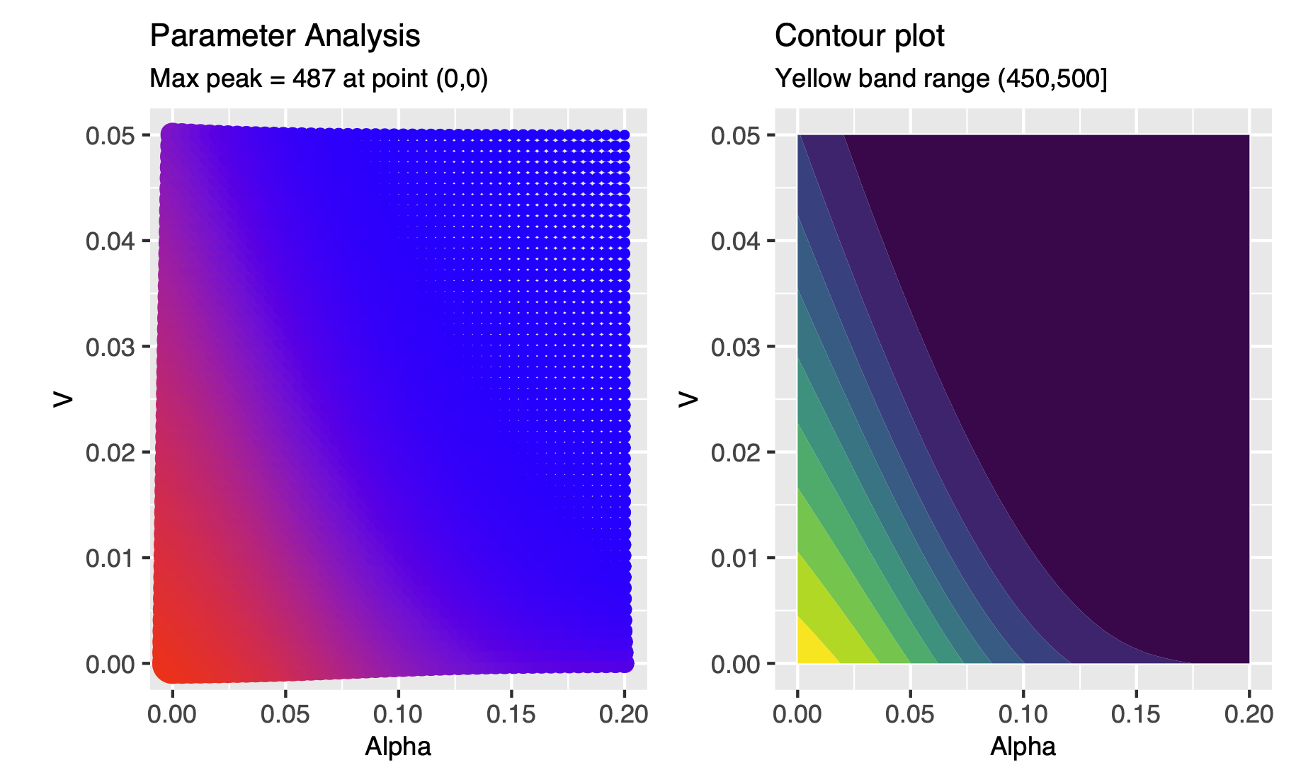
Speed of vaccination
No vaccination,
no change in mobility = Max point
Speed of mobility reduction

Slide 34
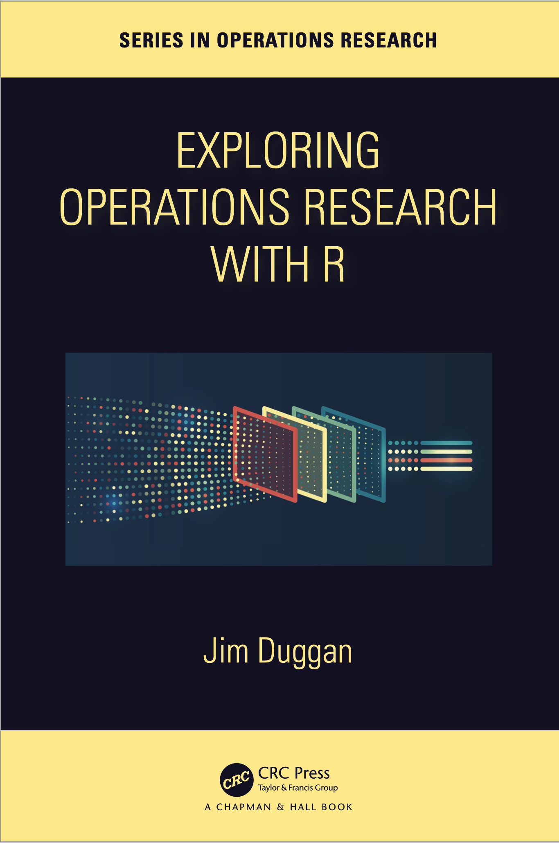
Recap.
R programming language can be a valuable tool – and way of thinking – which can be successfully applied to the field of operations research (OR).
Core R tools (tidyverse)
Application areas to OR:
Exploratory Data Analysis
Linear Programming
Agent-Based Simulation
System Dynamics

